Slide 1
PHP-database interaction

Slide 2
Steps:
Create a database connection
Perform a database query
Use returned data
Release returned data
Close the database connection
1and 5 can only happen once
Others 2-4 can perform often per php page

Slide 3
For steps 1 and 5 we need:
mysqli_connect($host,$user,$password,$database)
mysqli_close($connection)

Slide 4
Connect Steps
<?php
// Database interaction using PHP.
// Credentials
$dbhost = ‘ ‘;
$dbuser = ‘’;
$dbpass = ‘’;
$dbname = ‘’;
// 1. Create a database connection
$connection = mysqli_connect($dbhost, $dbuser, $dbpass, $dbname);
// 2. Perform database query
// 3. Use returned data (if any)
// 4. Release returned data
// 5. Close database
connectionmysqli_close($connection);?>

Slide 5
Now, the plan is to remove our array and use db
WE WILL REMOVE OUR ARRAY AND REPLACE IT WITH A FUNCTION

Slide 6
Create 2 files into our website folder
Add:
database.php
db_credentials.php

Slide 7
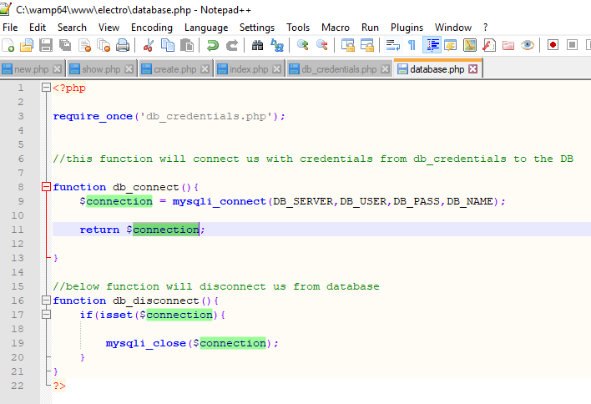

Slide 8
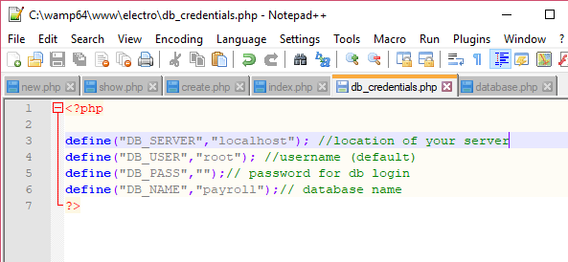

Slide 9
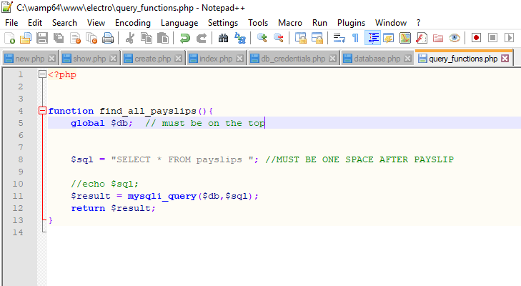

Slide 10
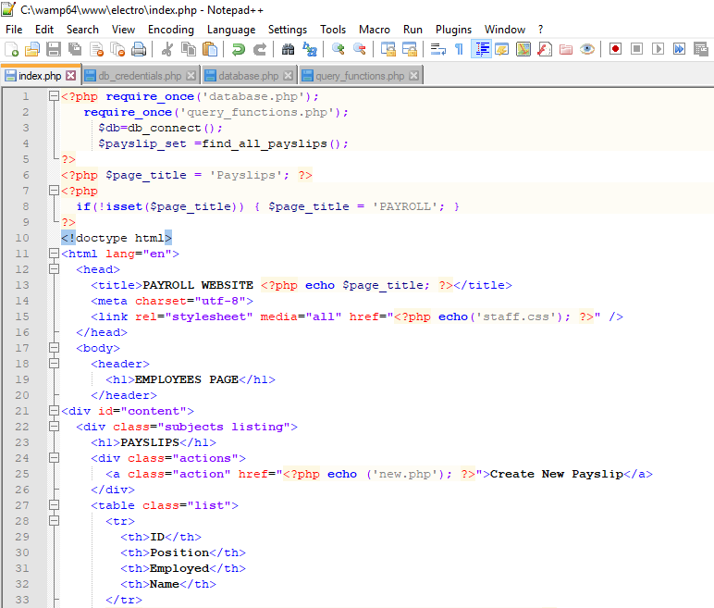

Slide 11
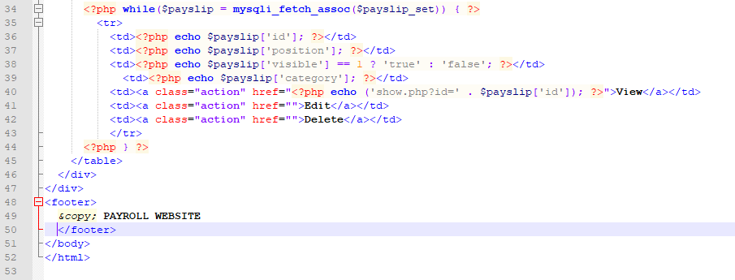

Slide 12
